Slide 1

RVM+
November 2025
Recyle vending machine
Smart Reverse Recycle Vending Machine with Gamification System

Slide 2
RVM+
TEAM MEMBERS
YASSEN AHMED ELSAYED (TEAM LEADER) ID:23101608
MARAWAN KHALED AHMED (TEAM MEMBER) ID:23101599
MOHAMED MOUSTAFA AWAD( TEAM MEMBER) ID:23101594
AHMED KHALED SAED(TEAM MEMBER) ID:23101545
MOHAMED ADEL MOHAMED(TEAM MEMBER) ID:23101899

Slide 3
RVM+
UseCase Diagram

Slide 4
RVM+
UseCase Diagram

Slide 5
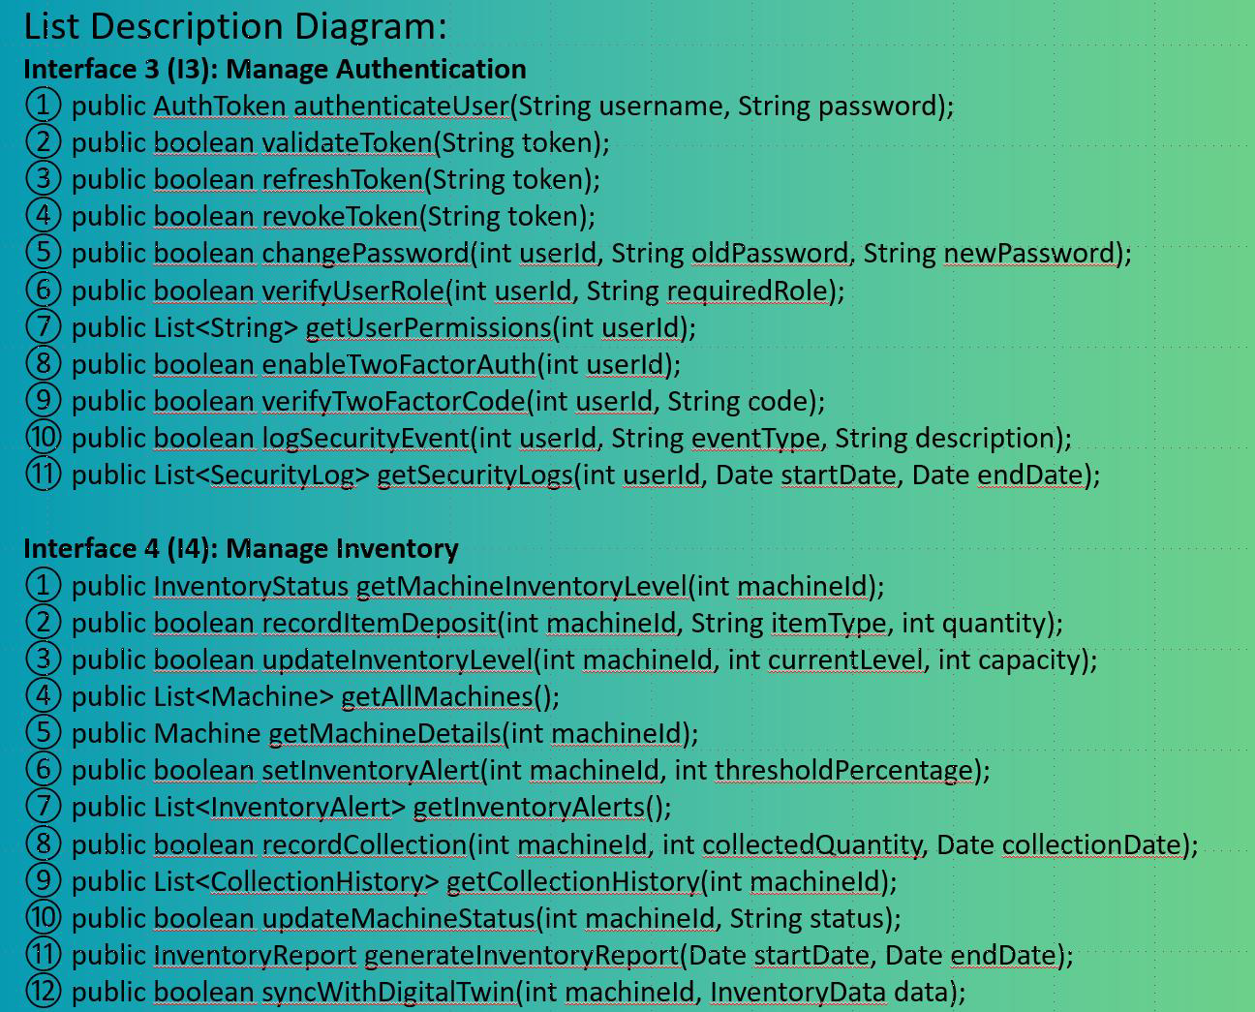
RVM+
UseCase Diagram

Slide 6
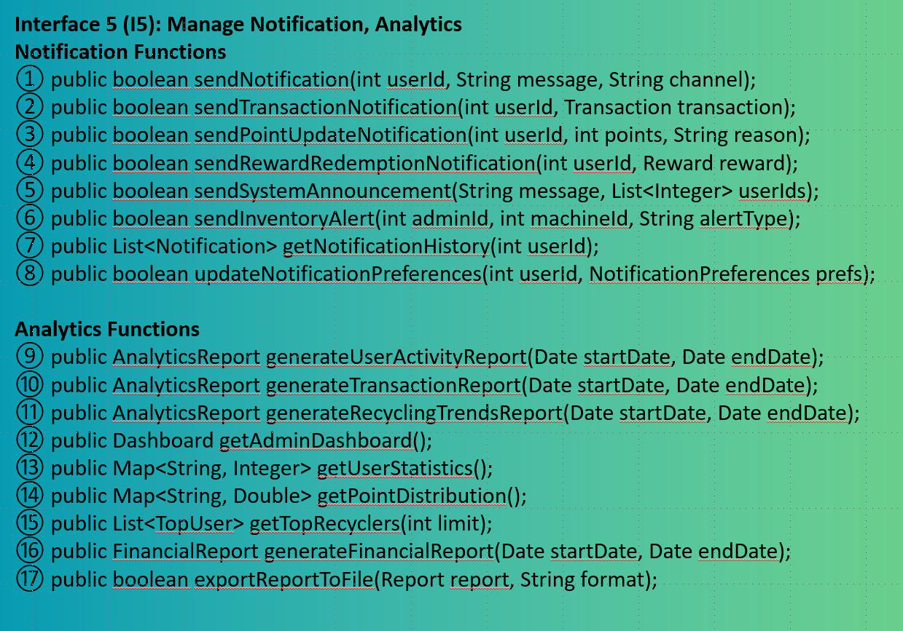
RVM+
UseCase Diagram

Slide 7
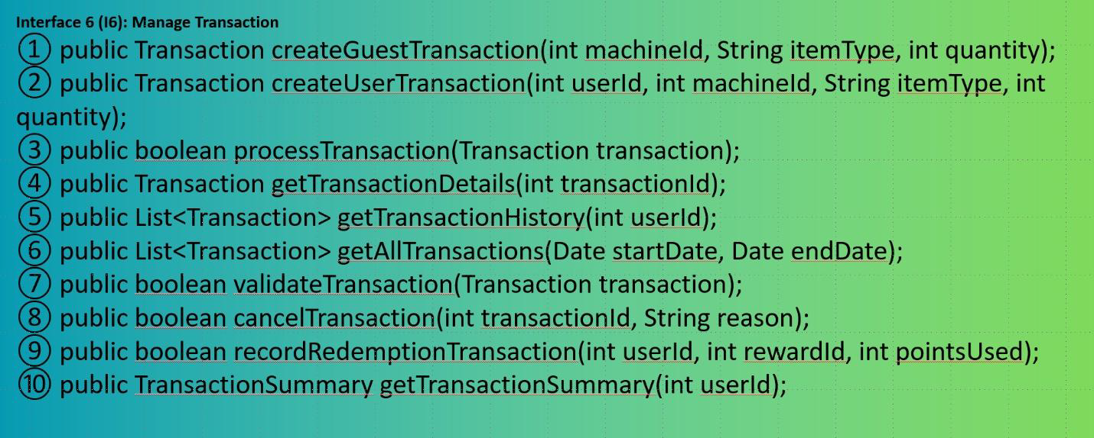
RVM+
UseCase Diagram

Slide 8
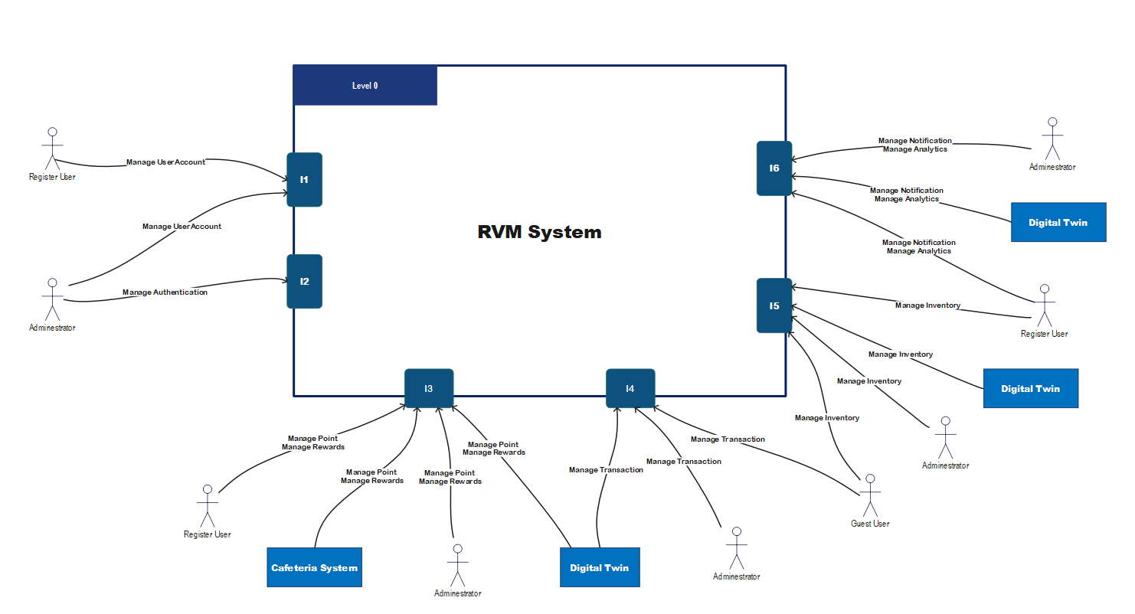
Software Architecture Level 0 Diagram
RVM+

Slide 9
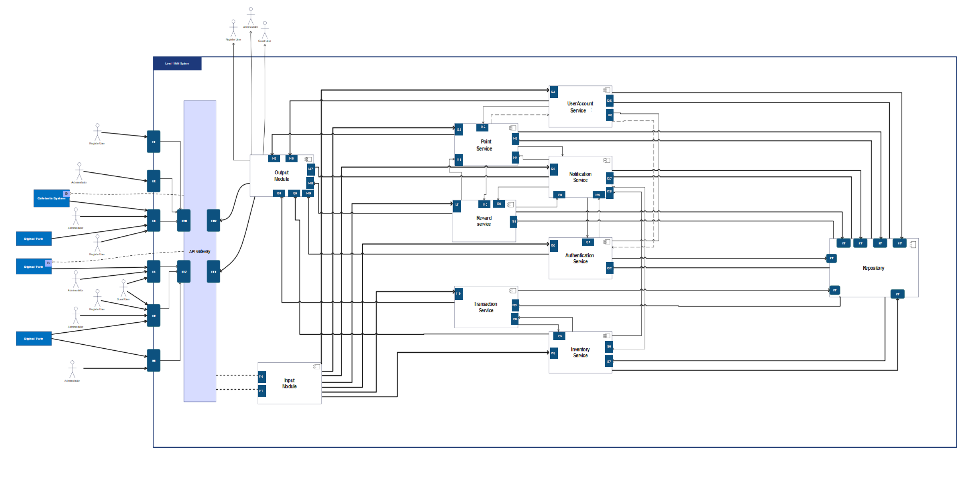
Software Architecture Level 1 Diagram
RVM+

Slide 10
RVM+
Software Architecture Level 2 Diagram

Slide 11
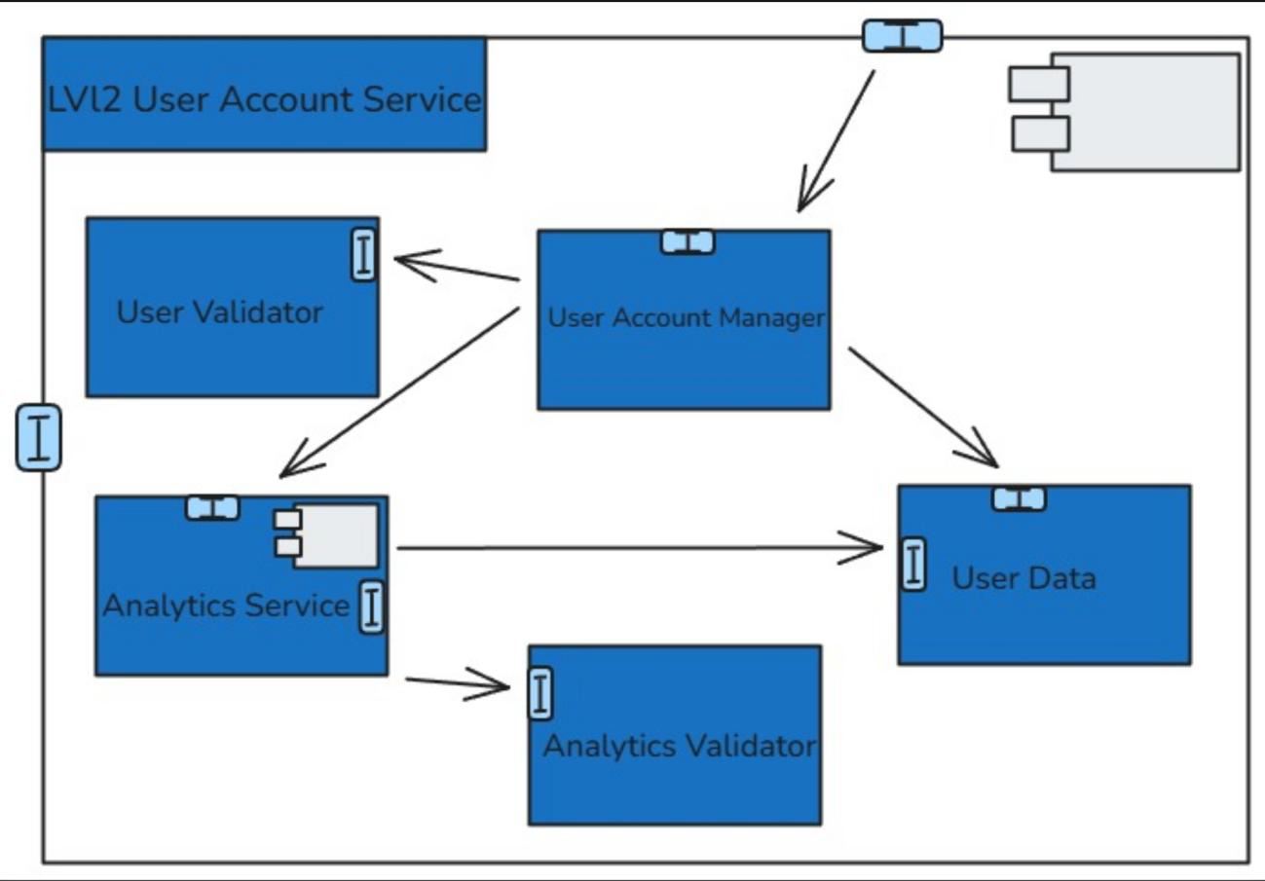
RVM+
Software Architecture Level 2 Diagram

Slide 12
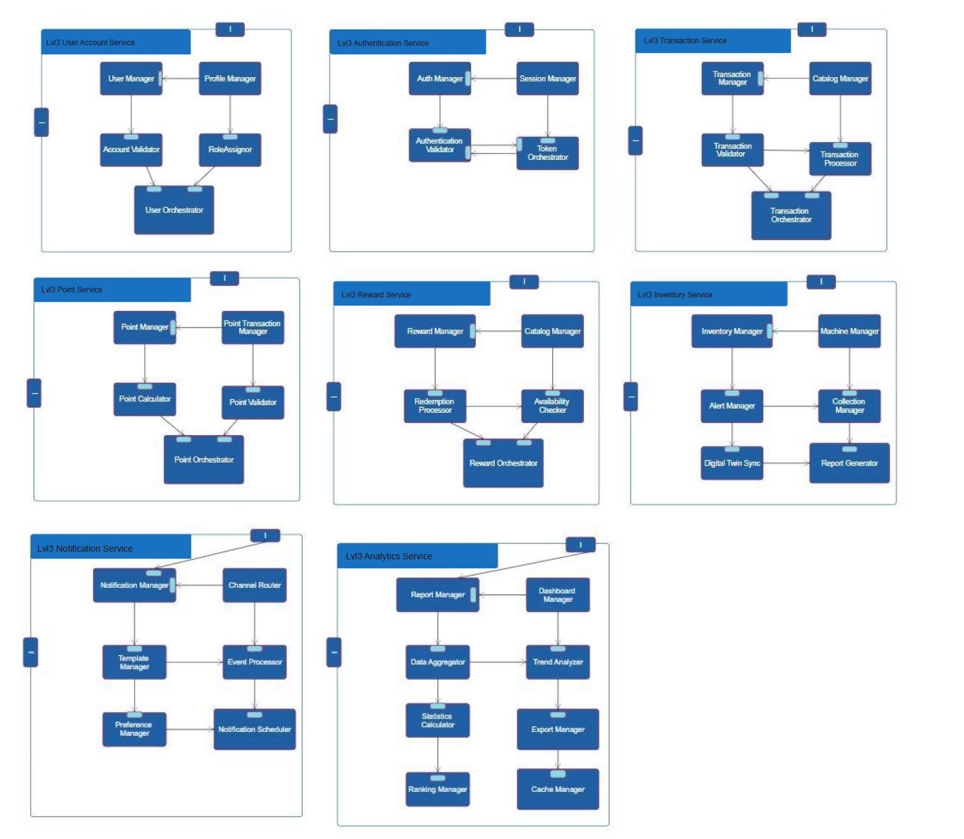
RVM+
Software Architecture Level 3 Diagram

Slide 13
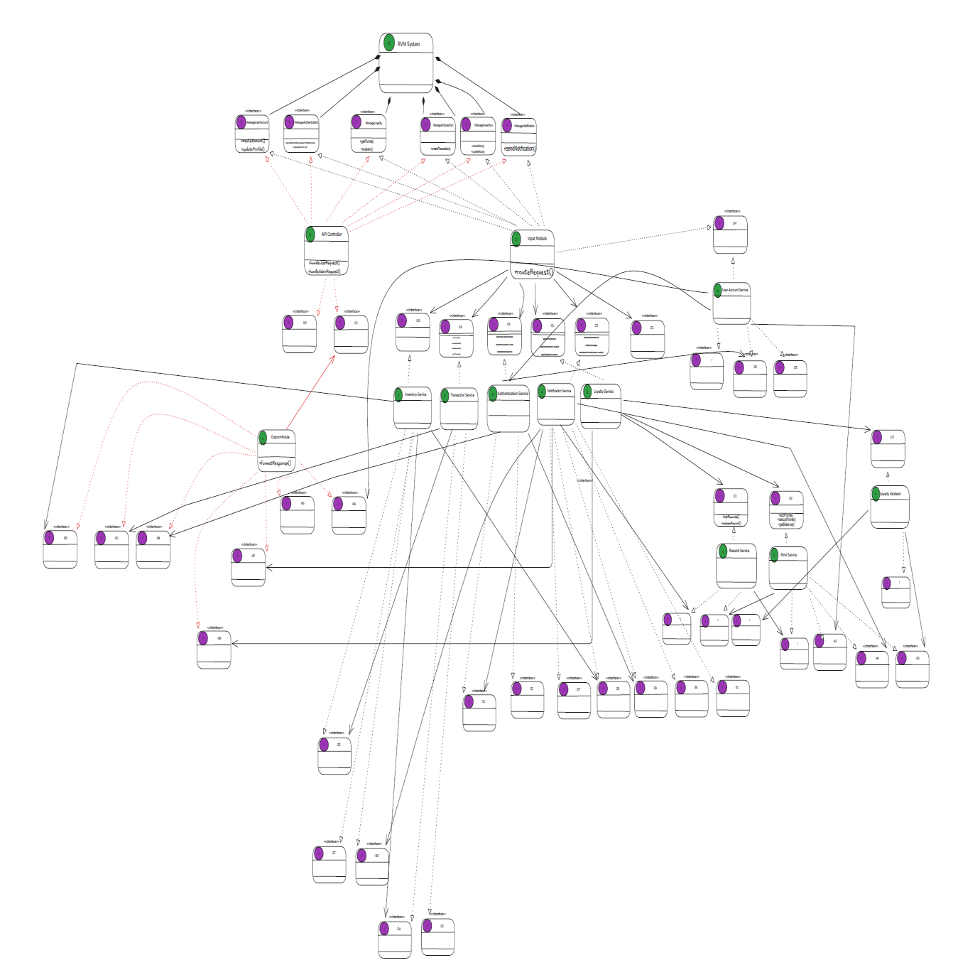
RVM+
Class Digram

Slide 14
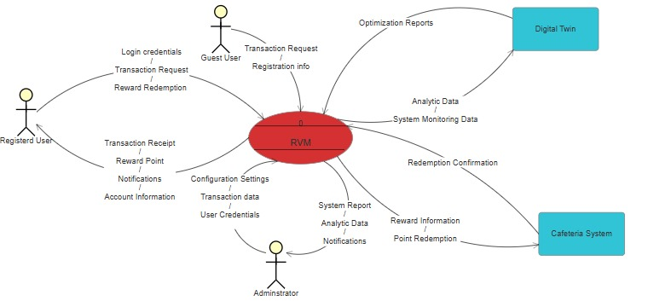
RVM+
Software Architecture DFD Level 0

Slide 15
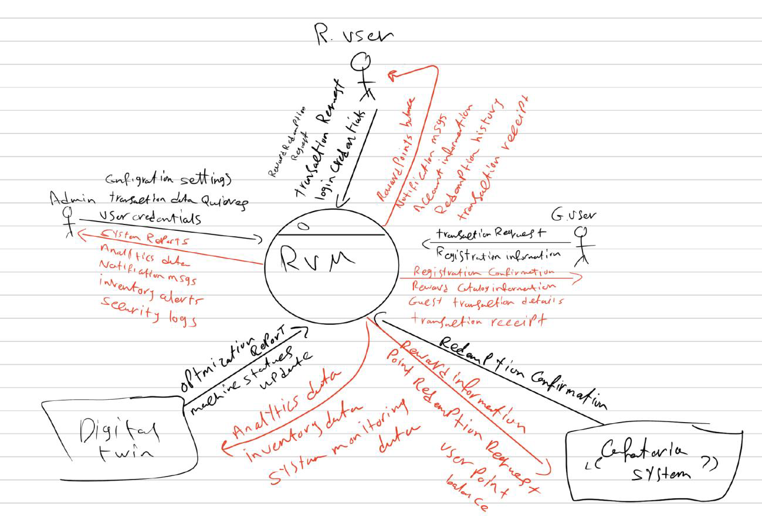
RVM+
Software Architecture DFD Level 0

Slide 16
RVM+
Software Architecture DFD Level 1

Slide 17
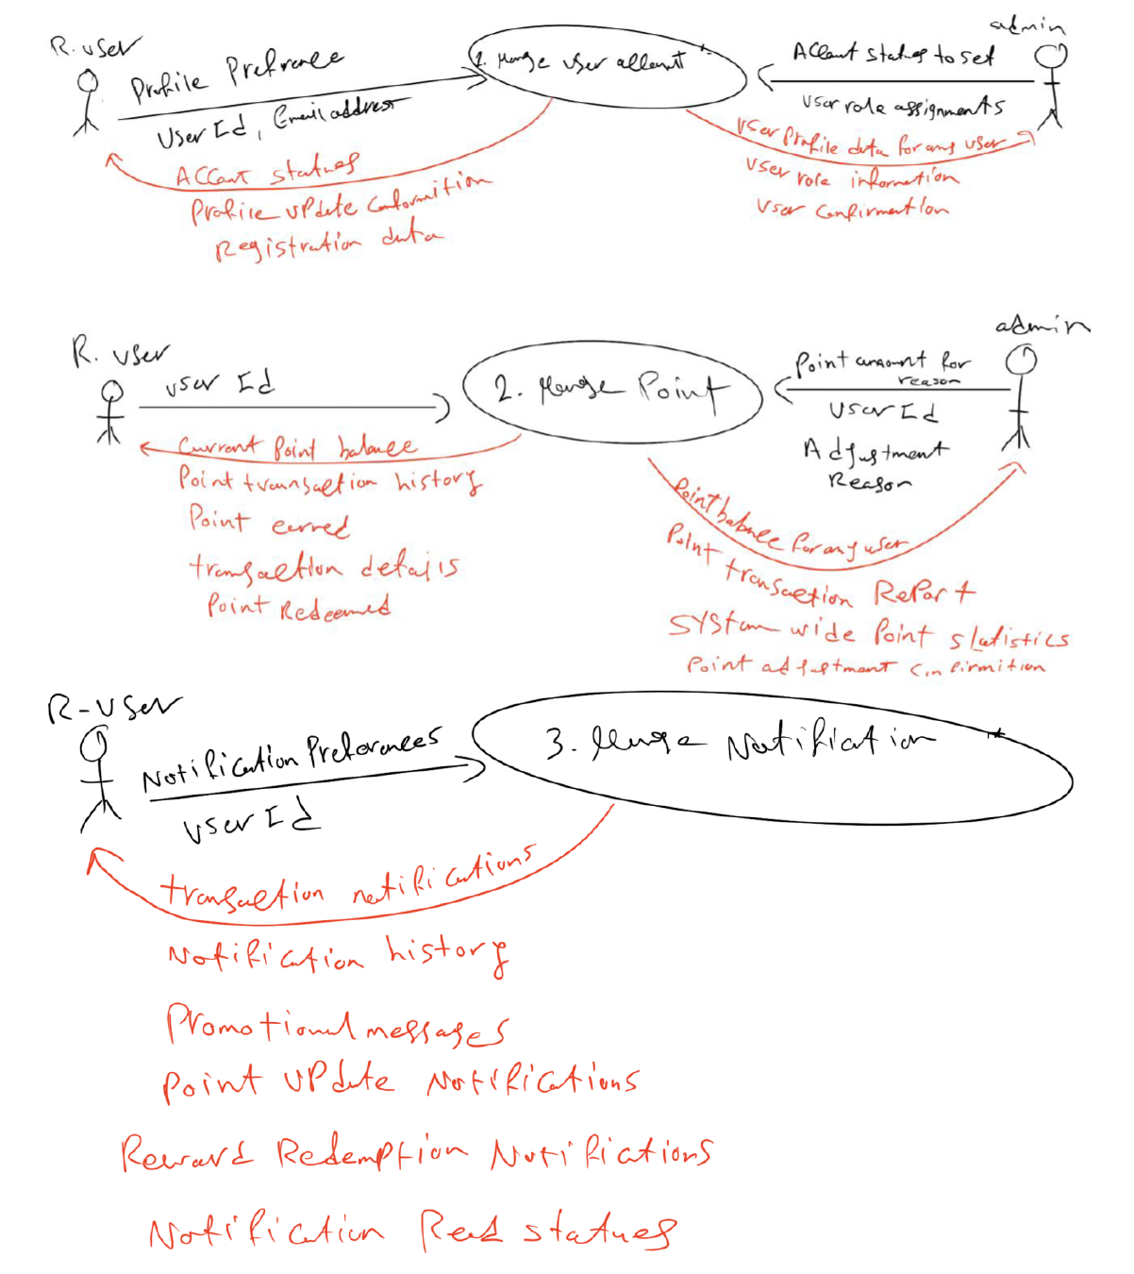
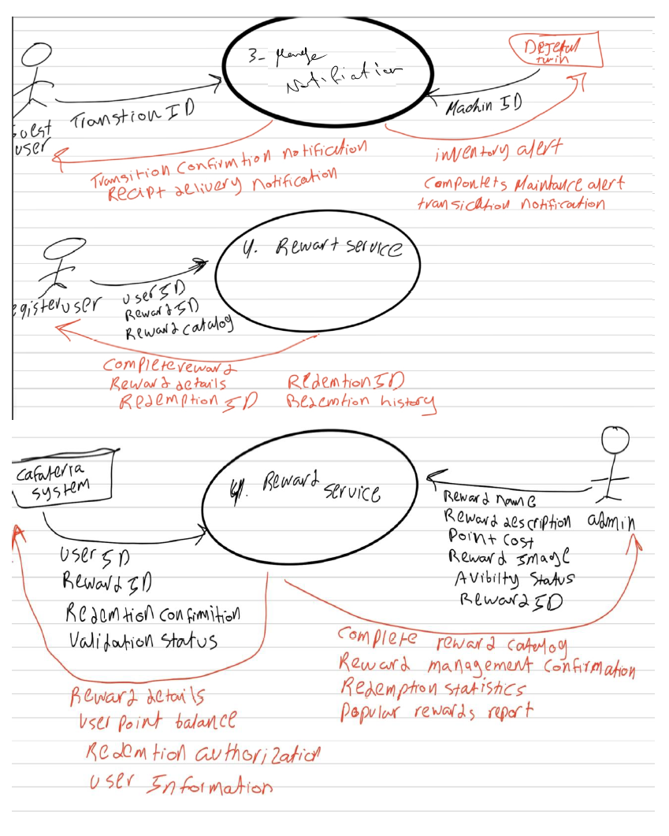
DFD Level 1

Slide 18
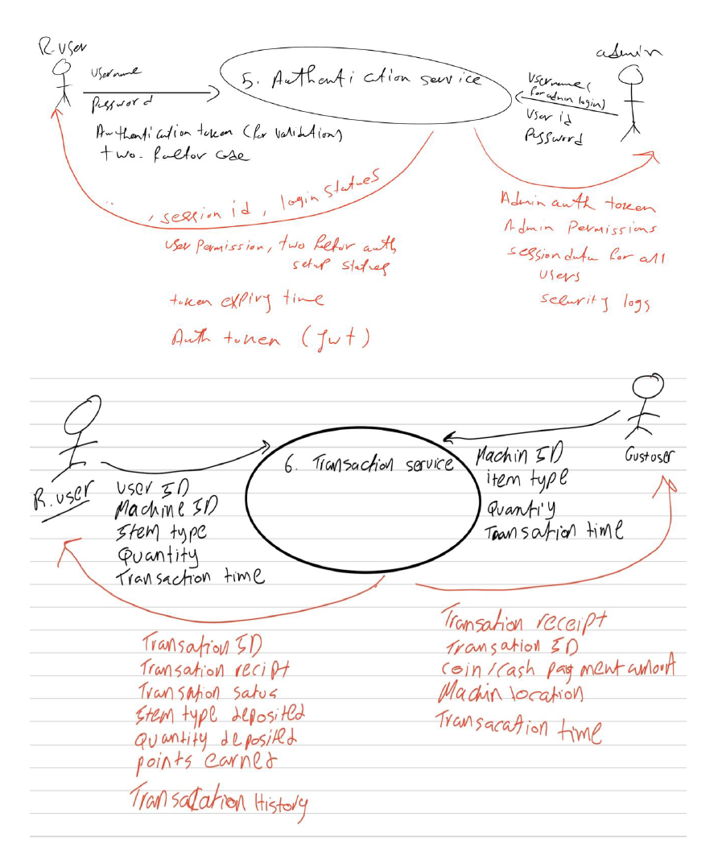
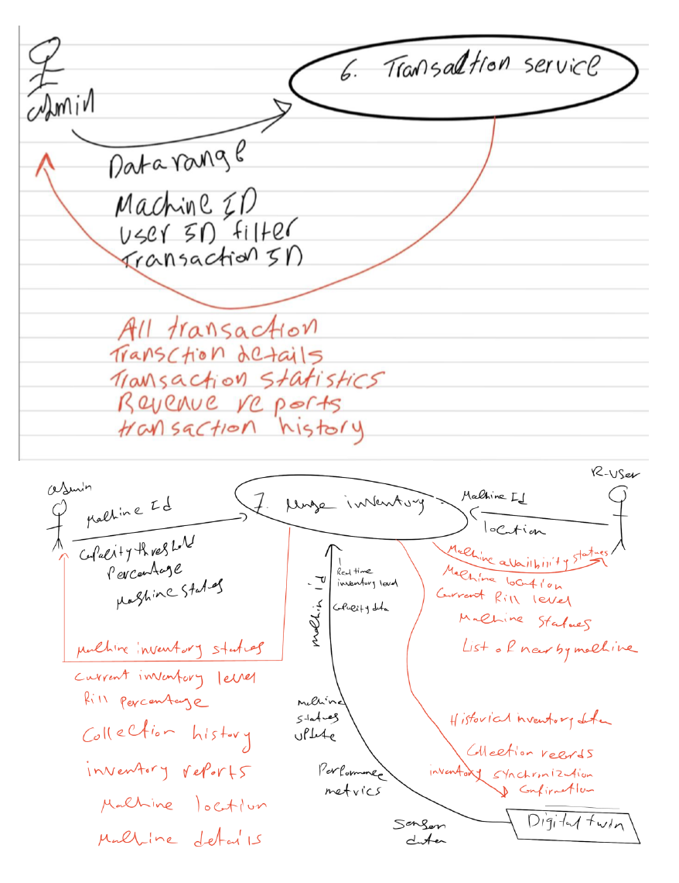
DFD Level 1

Slide 19
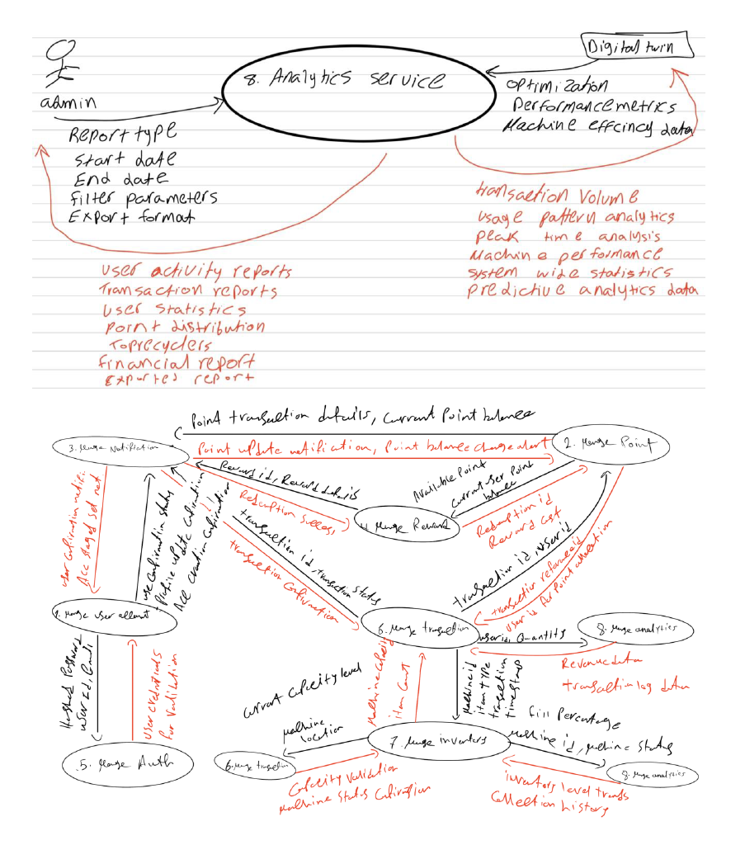
DFD Level 1

Slide 20
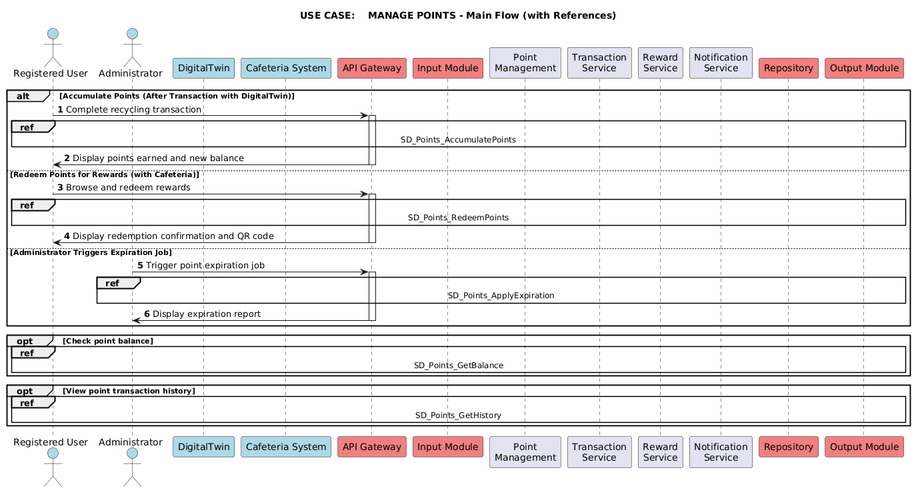
Sequence Diagram

Slide 21
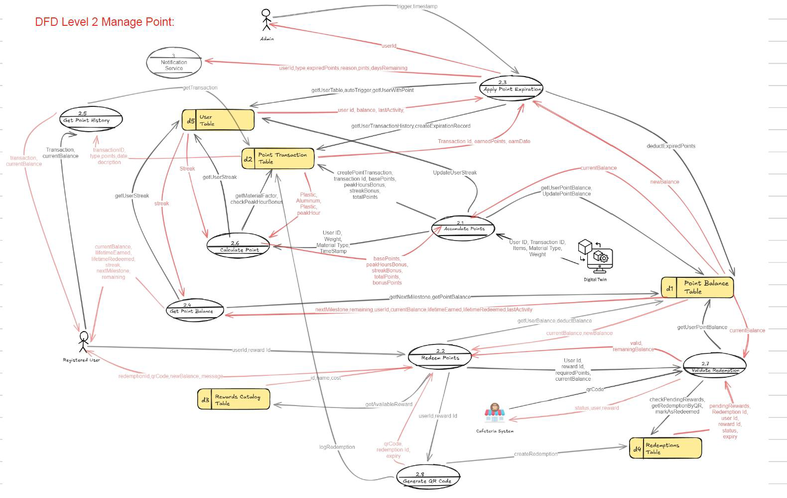
DFD Level 2

Slide 22
Sequence Diagram

Slide 23
DFD Level 2

Slide 24
Sequence Diagram

Slide 25
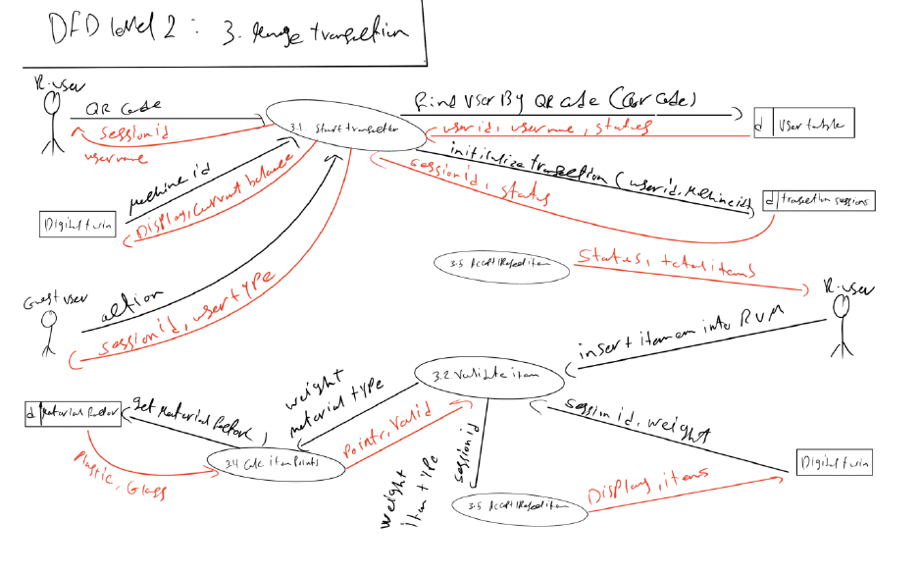
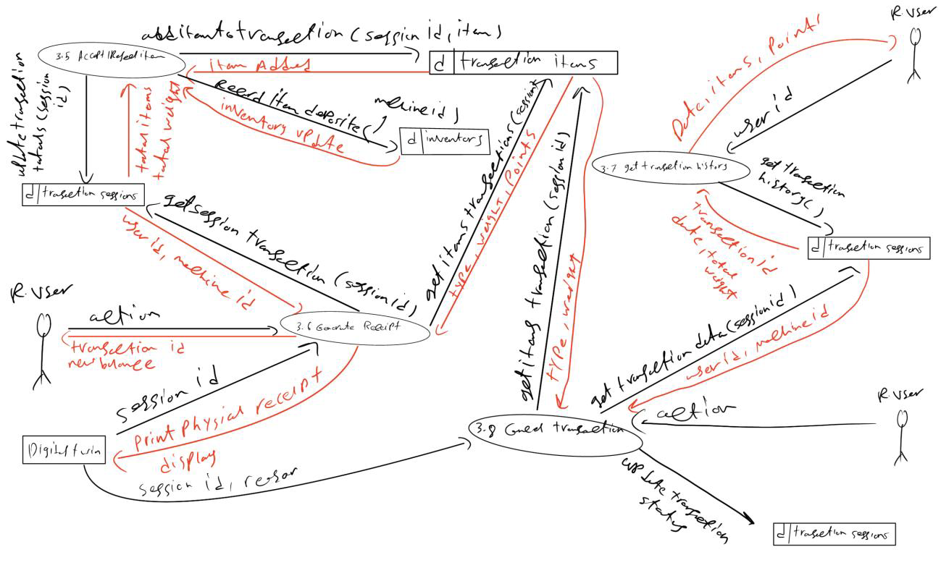
DFD Level 2

Slide 27
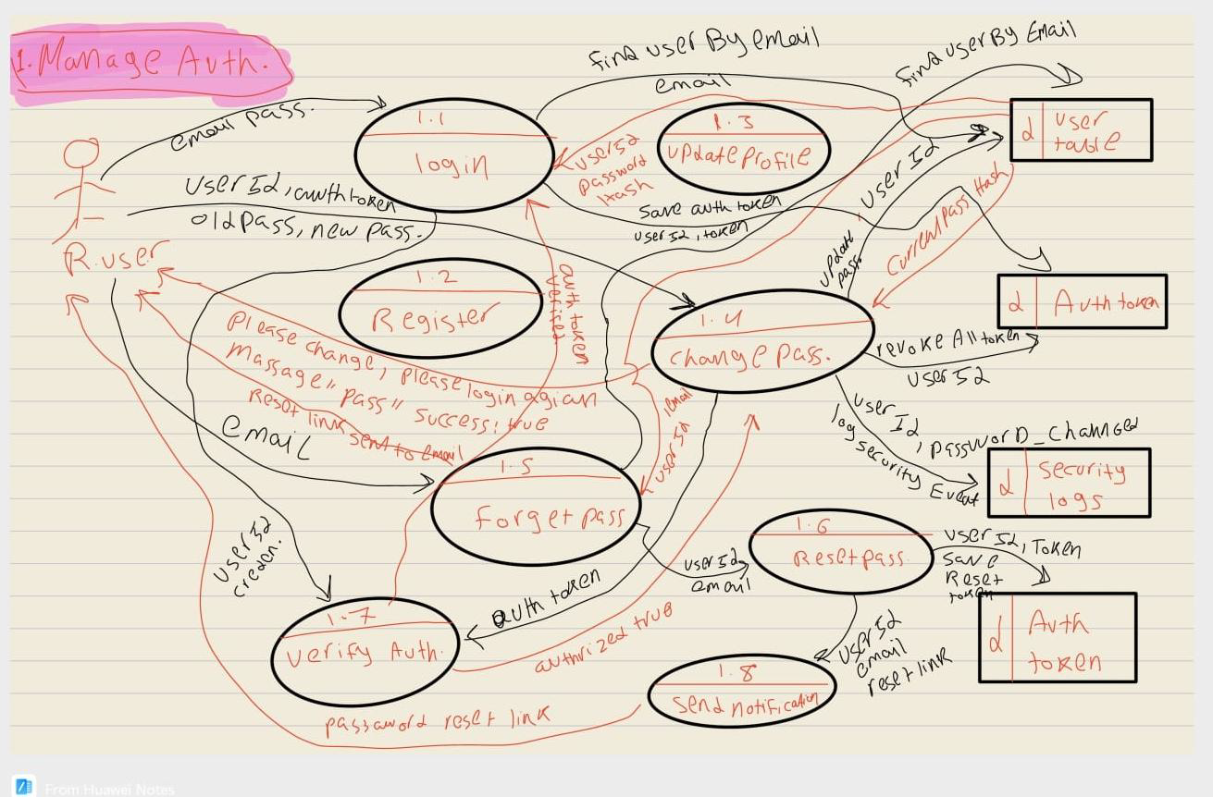
DFD Level 2

Slide 28
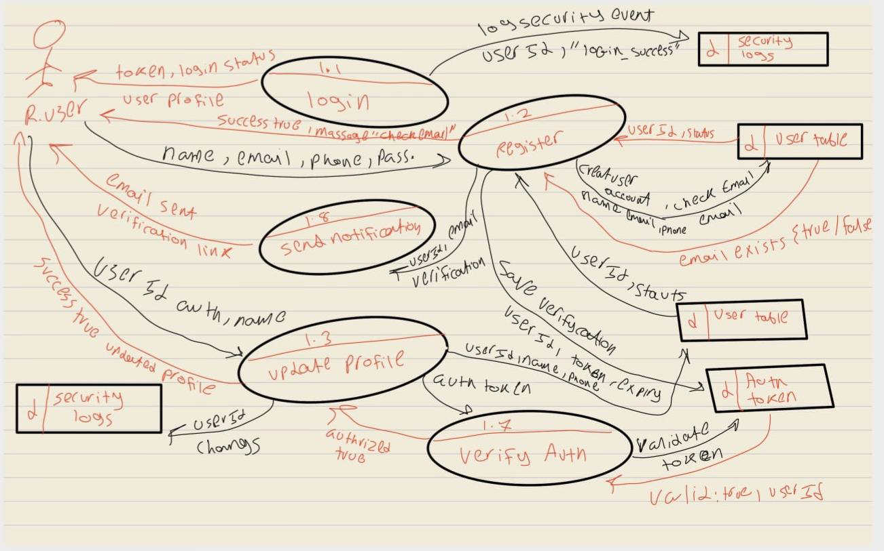
DFD Level 2

Slide 29
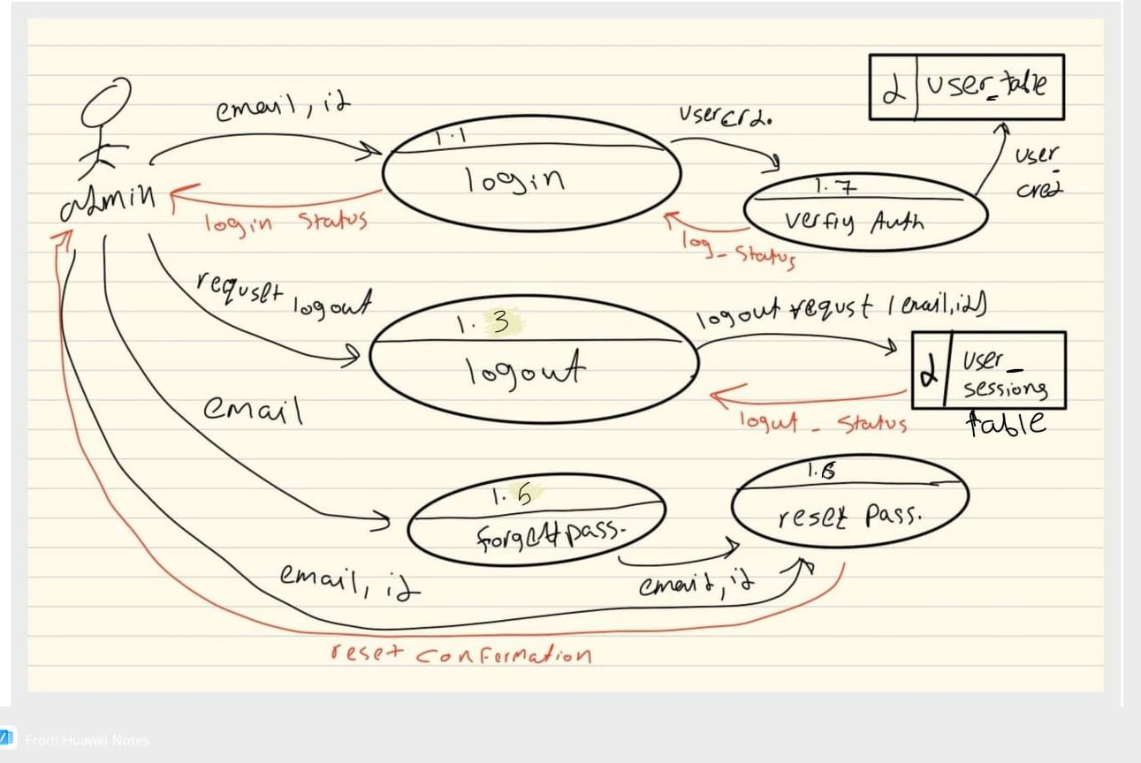
DFD Level 2

Slide 30
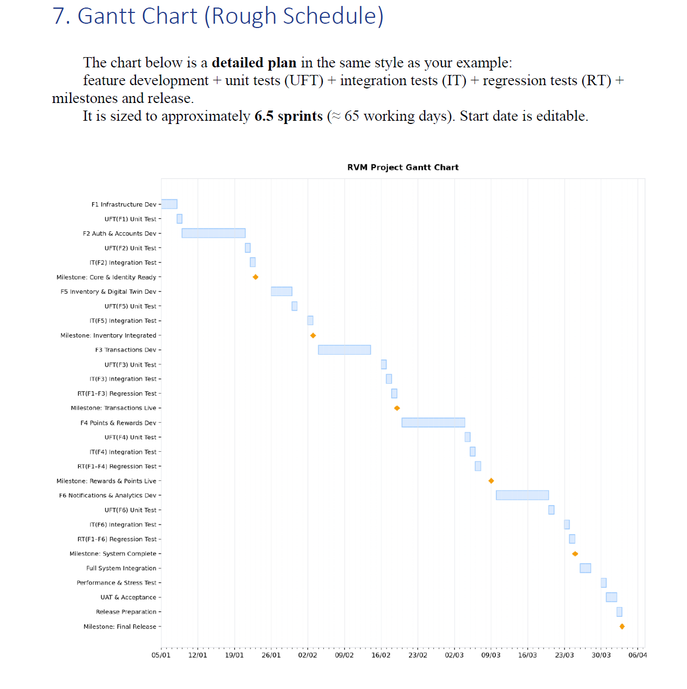
RVM+
Estimation

